Slide 1

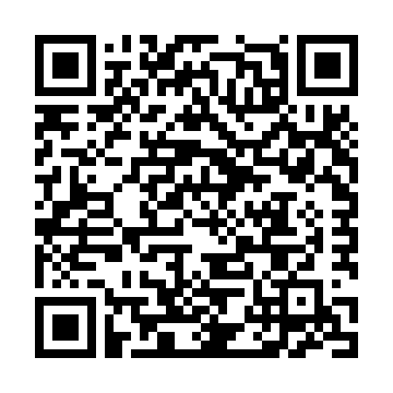
Draft-richardson-anima-smarkaklink
BRSKI enrollment with smart phones
Or:
How do I bootstrap operator-less
Registrars
Michael Richardson*
Jacques Latour
Abhishek Joshi
* All bad ideas are mine
https://www.sandelman.ca/SSW/ietf/anima/smarkaklink/ietf104_smarkaklink/ietf104_smarkaklink.html

Slide 2
Agenda
what’s the problem.
Rough idea of solution.
Why the name change!
Questions.

Slide 3
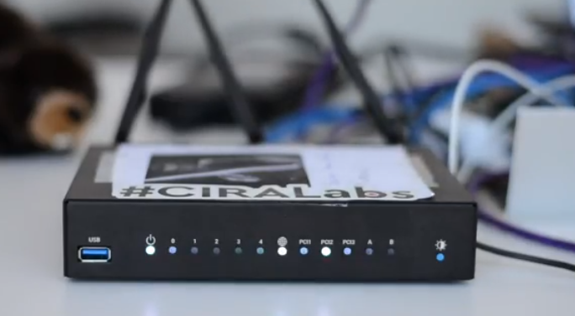
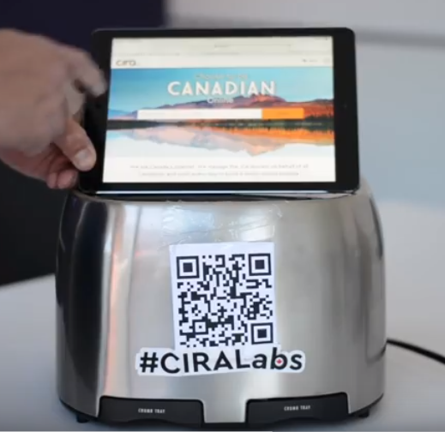
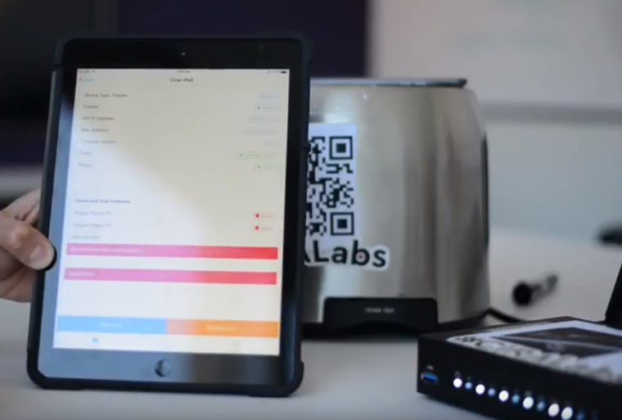
SecureHomeGateway.ca
Internet
https://github.com/CIRALabs/Secure-IoT-Home-Gateway
ICANN 2018 DEMO video
https://www.youtube.com/watch?v=LauvEBa4Z4s
RIPE 77 talk
https://ripe77.ripe.net/archives/video/2309/
ICANN 63 talk
URL unknown

Slide 4






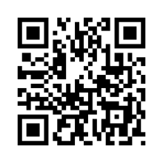

High Level MUD & IoT Device Provisioning Workflow
(1)
SHG
ACME.CORP
MUD
Repository
CIRA SHG
MUD Repository
MUD Supervisor
(3)
User accepts
provisioning
instructions
(2)
Send to
CIRA
(2)
Get vendor
MUD file
SHG
App
MUD Controller
HTTPS
RESTful
API
HOW TO
SETUP
THIS
TRUST?
(IP Tables)
(1)
(4)
(4)
IoT device added to network with specific network access controls
Network Access control:
Allow access to ACME.CORP
Allow to send alerts internally
Allow to be configured by app
Deny all other internet access
(1)
Scan MUD
QR code &
send to MUD
controller
MUD QR Code
ACME.CORP
IoT Water Sensor
<number><number><number><number><number><number><number><number>
CIRA Labs - Secure Home Gateway - 2018-09<footer><footer><footer><footer><footer><footer><footer>

Slide 5
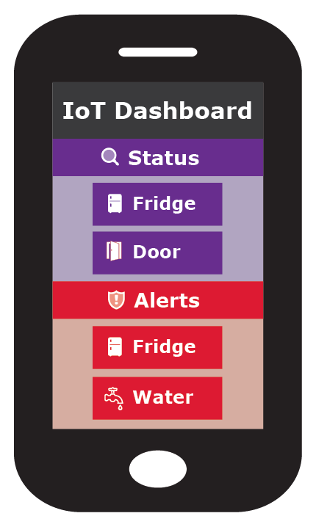
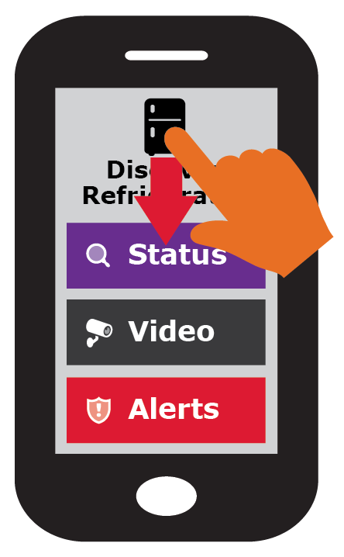
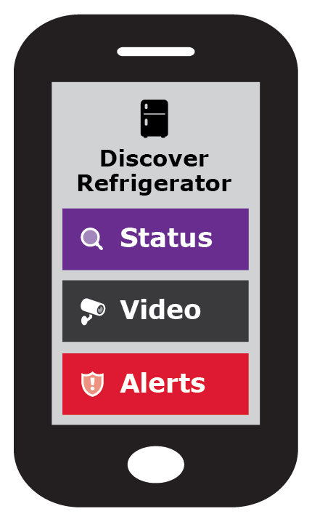





Simple user interface is key to this project: Swipe UP, DOWN, LEFT and RIGHT
Gateway provisioning, device discovery, device provisioning must be as simple as possible, intuitive for non experienced users, available as framework for default open source app.
Tinder for IoT devices
<number><number><number><number><number><number><number><number>
CIRA Labs - Secure Home Gateway - 2018-09<footer><footer><footer><footer><footer><footer><footer>

Slide 6
Requirements
Goal
Enroll a smartphone into PKI/database in Registrar of Home Router
First administrator can enable additional administrators or other roles with less rights (Role-Based Access control)
Assumptions
Router has QR code on sticker attached
Smartphone has LTE connection, or can move to another WiFI
Router might have no Internet until end-user types in PPPoE password.
Fries & Oskar: Device might NOT have Internet until home is occupied, or might never have Internet.

Slide 7
Initial bootstrap of app
How do I bootstrap
The first Client Certificate?
HTTPS connection from app to SHG.
NO PASSWORDS.
TLS ClientCertificate (pinned in database, CA part irrelevant)
TLS ServerCertificate:
mud.nc0a8fc4.r.securehomegateway.ca
(1)
SHG
MUD Supervisor
(3)
User accepts
provisioning
instructions
SHG
App
MUD Controller
(IP Tables)
ULA
Generated by router
As per RFC7084
WebPKI certificate
Installed at factory
W/ DNS name
%dig +short mud.nc0a8fc4.router.securehomegateway.ca aaaa
fd2a:c0a:8fc4::18e

Slide 8

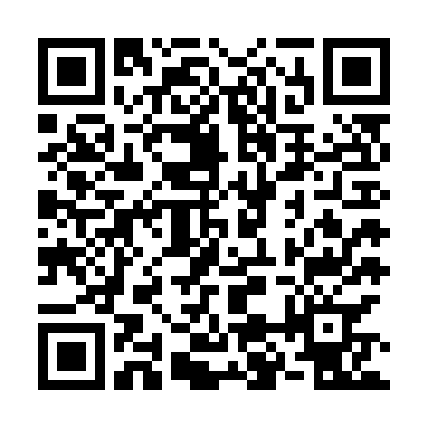

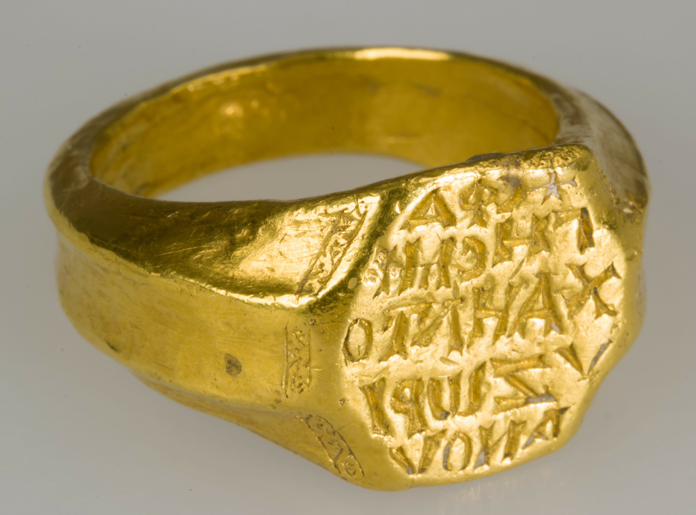
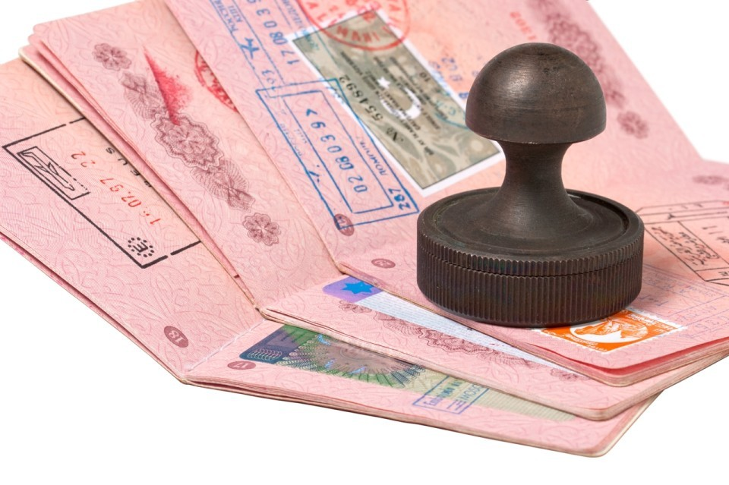
Roles are a changin’
Sorta seems
like a registrar
Consider new (adolescent) router to be a Pledge at first.
Consider Smartphone to be a new type of Join Proxy at first
Change roles later on.
Internet
(1: scan)
MASA
(2: request VR)
(3)
voucher-request VR
(3)
voucher-request VR
voucher

Slide 9
Smartphone becomes client!
Smartphone now becomes the EST client
Router now becomes a registrar
Smartphone uses authorized TLS connection as secure transport for enrollment of new identity. As first device, becomes administrator, configures the device.
MASA
Internet
(4) RFC7030 EST
/simplerenroll
(5) PKIX cert
Returned and pinned
Connection
Authorized
By voucher

Slide 10
SmartPledge -> Smarkaklink
“SmartPledge” name was trying to be some kind of portmanteau of smartphone pledge
But, smartphone is not always the pledge, the router is.
Smartphone has multiple roles
SmarKaklink invokes sound of wine glasses clinking.
Redrew images according to BRSKI left(pledge) to right (MASA) view.

Slide 11
Some notes
Smartphone, as pseudo-registrar can still access audit-log from MASA!
Smartphone identity is pseudonymous, but MASA still logs it, so smartphone can recognize “itself”
Opportunity for further enrollment provided via OAUTH2 interaction between MASA and Smartphone

Slide 12
What about this QR code? Who else uses QR code?
WiFi Alliance DPP
Released in summer
Crypto done by Dan Harkins.
Uses Public Key privated on QR code
Runs over new management frames in 802.11, presently inaccessible on current smartphone Oses.
We are writing code today.
EAP-NOOB
Been around for awhile.
Requires dynamic QR code ... or
Maybe leverage many LEDs on front of router?
Not interested in AAA back-end, it would have to be co-located in phone.

Slide 13
smarkaklink-01
Leverages DPP QR code format
Want to leverage all of the crypto with the goal of “upgrading” to DPP when smartphone APIs become available.
(Extends DPP QR code, despite WiFi Alliance not providing “IANA Considerations”)
Tweaks BRSKI to include a /requestvoucherrequest to avoid need for Registrar to contact MASA directly.

Slide 14
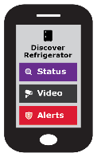
Time Sequence Diagram
MASA
AR
Scan QR
Code on
Encrypt (ECIES)
With public
Key of AR
Generate Self-signed
Use as ClientCertificate
Get Certificate (optional?)
signed by MASA
Visit URL
Given QR
Do OAUTH2 dance?
Connect to BRSKI port
/requestvoucherrequest (+ SPnonce)
Receive voucherrequest
(w/ SPnonce)
Send to voucherrequest
To MASA
Receive
voucher
Send voucher
To AR
Receive reply,
exit provisional state
Send telemetry
Reply to MASA

Slide 15
Time Sequence Diagram
MASA
Registrar
EST7030
/simpleenroll
PKIX cert
Specific to this router
SHG specific
APIs

Slide 16
DNSSEC and Advanced Homenet Naming
Device will come with “coupon” for delegated DNS for home: allthegoodnames.securehomegateway.ca
Initially, this was going to
Come in the form of a
QR code
Delegated DNS will be secured with DNSSEC, and use RFC8078 after initial setup via HTTPS API.
Somehow this could
Be done as part
Of enrollment, resulting in
A single QR code, but
Unclear how.

Slide 17
Questions/Discussion
I’m not sure this belongs in ANIMA,
but if not, where?

